Slide 1
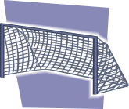




Changing the Point of Attack
Back safe zone for any player to drop into (if needed when time is right)

